Slide 1
Embedded Hardware: Hardware Building Blocks Board Buses

Slide 2
Buses
Major components of the embedded board such as the master processor, I/O components, and memory are interconnected via buses
Bus: Collection of wires carrying various data signals, addresses, and control signals between all the major components
Control signals include clock signals, requests, acknowledgements, data type, etc.
At least one bus interconnects the other major components in the system
Embedded boards with several buses connecting components that need to inter-communicate

Slide 3
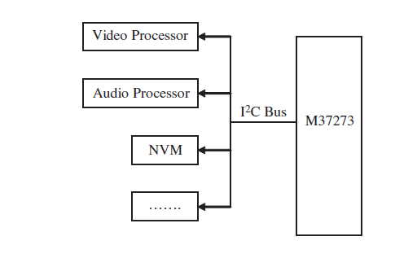
Bridges
Bridges on the board connect the various buses and carry information from one bus to another
A bridge can automatically provide a transparent mapping of address information when data is transferred from one bus to another
For example, if the byte ordering differs, the bridge can handle the byte swapping

Slide 4
Board buses types
Board buses are classified into three types:
System buses
backplane buses
I/O buses
System buses also referred to as “main buses” or “local buses” or “processor-memory” buses
System buses interconnect external main memory and cache to the master CPU and/or any bridges to the other buses
System buses are typically shorter, higher speed, custom buses

Slide 5
Cont’d..
Backplane buses are also typically faster buses that interconnect memory, the master processor, and I/O, all on one bus
I/O buses, also referred to as “expansion buses” or “external buses” or “host buses”
Extensions of the system bus are used to connect the remaining components to the master CPU, to each other, to the system bus via a bridge
Also to the embedded system itself, via an I/O communication port
I/O buses are typically standardized buses that can be either shorter, higher speed buses such as PCI and USB
Longer, slower buses such as SCSI

Slide 6
Difference between I/O buses and system buses
The major difference between system buses and I/O buses is the possible presence of IRQ (interrupt request) control signals on an I/O bus
An IRQ line allows for I/O devices on a bus to indicate to the master processor that an event has taken place or an operation has been completed using a signal
Different I/O buses can have different impacts on interrupt schemes
An ISA bus, for example, requires that each card that generates interrupts must be assigned its own unique IRQ value
The PCI bus, on the other hand, allows two or more I/O cards to share the same IRQ value

Slide 7
Buses types
Buses can be further divided into
Expandable
Non-expandable.
Expandable bus such as PCMCIA, PCI, IDE, SCSI, USB, and so on
Expandable buses is one in which additional components can be plugged into the board on-the-fly
Non-expandable bus such as DIB, VME, I2C
Non-expandable is one in which additional components cannot be simply plugged into the board and then communicate over that bus to the other components.

Slide 8
Cont’d
Expandable buses are more flexible because components can be added ad-hoc to the bus
Expandable buses tend to be more expensive to implement
Performance can be negatively impacted by the addition of too many poorly designed components onto the expandable bus.

Slide 9
Bus Arbitration and Timing
Board devices obtain access to a bus using a bus arbitration scheme
Bus arbitration is based upon devices being classified as
Master devices
Slave devices
Master device : devices that can initiate a bus transaction
Slave devices : devices which can only gain access to a bus in response to a master device’s request
The simplest arbitration scheme is for only one device on the board: the master processor, while all other components are slave devices.
No arbitration is necessary when there can only be one master.
For buses with multiple masters, some have an arbitrator that determines under what circumstances a master gets control of the bus

Slide 10
Cont’d..
There are several bus arbitration schemes used for embedded buses:
Dynamic Central parallel
Centralized serial (daisy-chain)
Distributed self-selection
Dynamic central parallel arbitration is a scheme in which the arbitrator is centrally located
All bus masters connect to the central arbitrator
Masters are then granted access to the bus via a FIFO or priority-based system
FIFO queue that stores a list of master devices ready to use the bus in the order of bus requests

Slide 11
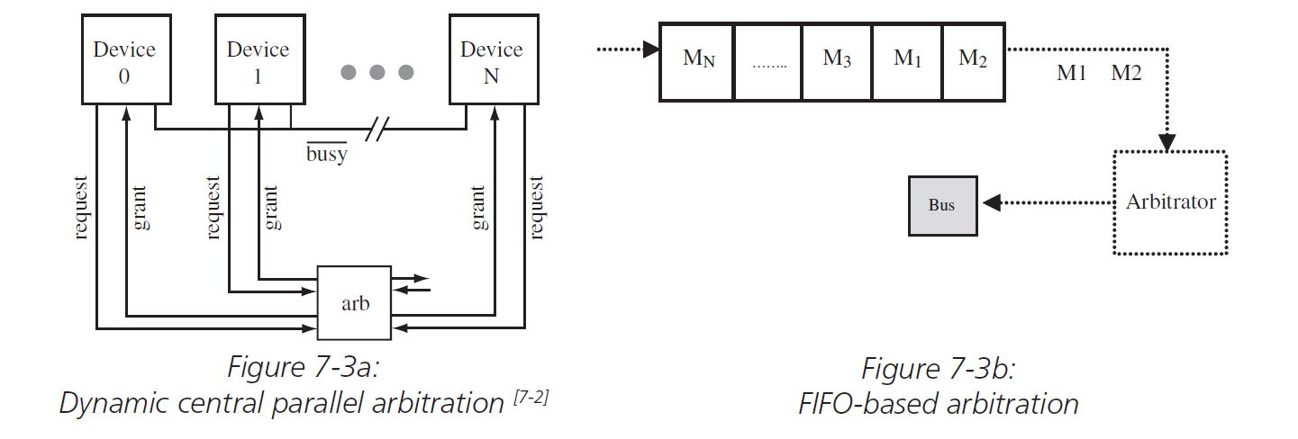
Cont’d
Master devices are added at the end of the queue, and are allowed access to the bus from the start of the queue
Drawback: Possibility of the arbitrator not intervening if a single master at the front of the queue maintains control of the bus, never completing and not allowing other masters to access the bus

Slide 12
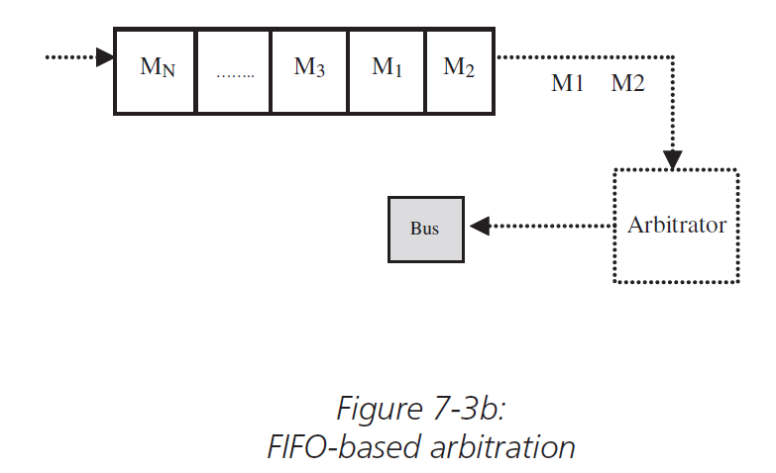
Cont’d

Slide 13
Priority based arbitration scheme
The priority arbitration scheme differentiates between masters based upon their relative importance to each other and the system
Basically, every master device is assigned a priority, which acts as an indicator of order of precedence within the system
If the arbitrator implements a preemption priority-based scheme, the master with the highest priority always can preempt lower priority master devices
In the figure, it shows three master devices
Master 1- lowest priority device
Master 3-highest priority
Master 3 preempts master 2, and Master 2 preempts master 1 for the bus

Slide 14
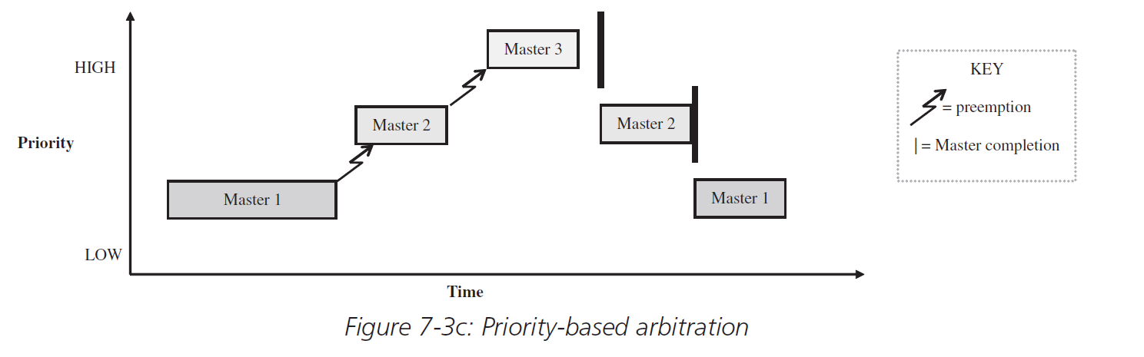
Cont’d

Slide 15
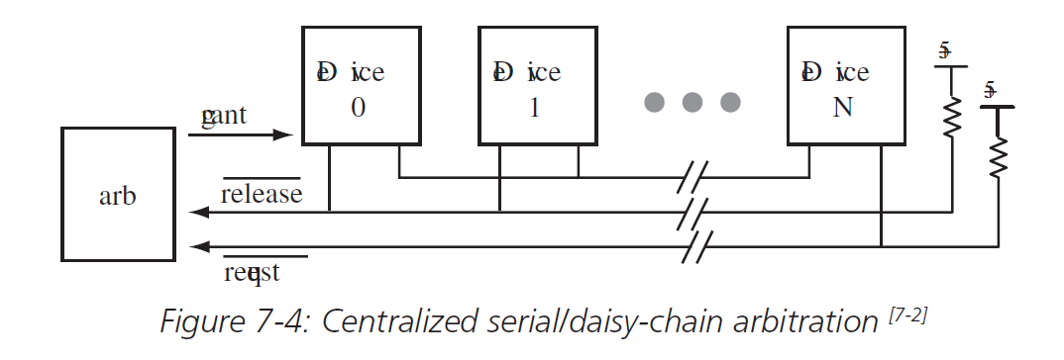
Central-serialized or daisy-chain arbitration
Central-serialized arbitration: a scheme in which the arbitrator is connected to all masters, and the masters are connected in serial.
Without considering of which master makes the request for the bus, the first master in the chain is granted the bus and passes the “bus grant” on to the next master in the chain
Device
Device
Device
grant
request

Slide 16
Distributed arbitration schemes
Distributed arbitration schemes: means there is no central arbitrator and no additional circuitry
In the above scheme, masters arbitrate themselves by trading priority information to determine if a higher priority master is making a request for the bus
Assign the bus even by removing all arbitration lines and waiting to see if there is a collision on the bus

Slide 17
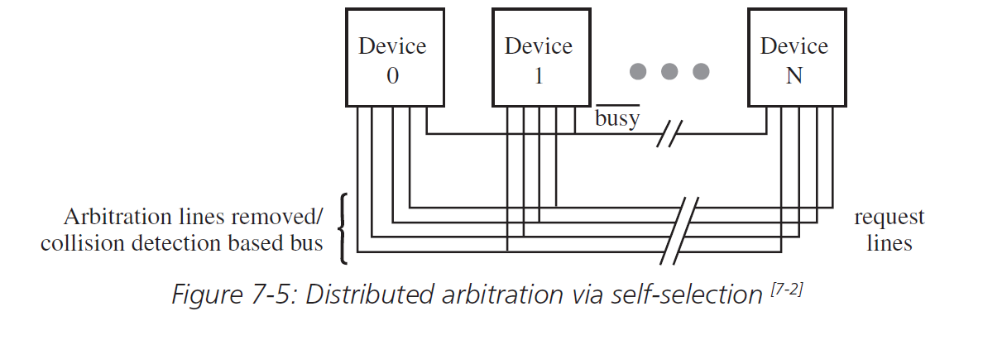
Cont’d

Slide 18
Cont’d
Bus arbitrators can grant a bus in two ways:
Atomically: until that master is finished with its transmission
Split: Arbitrator can preempt devices in the middle of transactions, switching between masters to allow other masters to have bus access
Two types of transactions:
READ (receive)
WRITE (transmit)

Slide 19
Bus timing schemes types and Synchronous
Buses timing schemes are of two types:
Synchronous bus timing schemes
Asynchronous bus timing schemes
Synchronous bus includes a clock signal among the other signals it transmits, such as data, address and other control information
Components using a synchronous bus all are run at the same clock rate as the bus and data is transmitted either on the rising edge or falling edge of a clock cycle

Slide 20
Asynchronous timing schemes
An asynchronous bus transmits no clock signal, but transmits other “handshaking” signals instead, such as request and acknowledgment signals
While the asynchronous scheme is more complex for devices having to coordinate request commands, reply commands, and so on, an asynchronous bus has no problem with the length of the bus or a larger number of components communicating over the bus, because a clock is not the basis for synchronizing communication
An asynchronous bus does need some other “synchronizer” to manage the exchange of information, and to interlock the communication

Slide 21
Transferring mode schemes types
The most common schemes
Single
Blocked
Single: an address transmission precedes every word transmission of data, and blocked, where the address is transmitted only once for multiple words of data
Blocked: increase the bandwidth of a bus and is sometimes referred to as burst transfer scheme
It is commonly used in certain types of memory transactions, such as cache transactions

Slide 22
Cont’d
Drawback of a blocked scheme: negatively impact bus performance in that other devices may have to wait longer to access the bus
Strengths of single transmission : not requiring slave devices to have buffers to store addresses and the multiple words of data associated with the address, as well as not having to handle any problems that could arise with multiple words of data either arriving out of order or not directly associated with an address

Slide 24
Non-Expandable Bus: I2C Bus Example
The I2C (Inter IC) bus interconnects processors that have incorporated an I2C on-chip interface, allowing direct communication between these processors over the bus
A master/slave relationship between these processors exists at all times, with the master acting as a master transmitter or master receiver.
The I2C bus is a two-wire bus with one serial data line (SDA) and one serial clock line (SCL)
The processors connected via I2C are each addressable by a unique address that is part of the data stream transmitted between devices
The I2C master initiates data transfer and generates the clock signals to permit the transfer
Basically, the SCL just cycles between HIGH and LOW

Slide 25
Cont’d
The master then uses the SDA line (as SCL is cycling) to transmit data to a slave
A session is started with a “START” is initiated when the master pulls the SDA port (pin) LOW while the SCL signal is HIGH, whereas a “STOP” condition is initiated when the master pulls the SDA port HIGH when SCL is HIGH
With regard to the transmission of data, the I2C bus is a serial, 8-bit bus
This means that, while there is no limit on the number of bytes that can be transmitted in a session, only one byte (8 bits) of data will be moved at any one time, 1 bit at a time (serially)

Slide 26
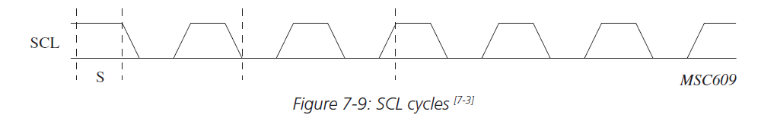
Cont’d
This translates into using the SDA and SCL signals is that a data bit is “read” whenever the SCL signal moves from HIGH to LOW, edge to edge
If the SDA signal is HIGH at the point of an edge, then the data bit is read as a “1”
If the SDA signal is LOW, the data bit read is a “0”

Slide 27
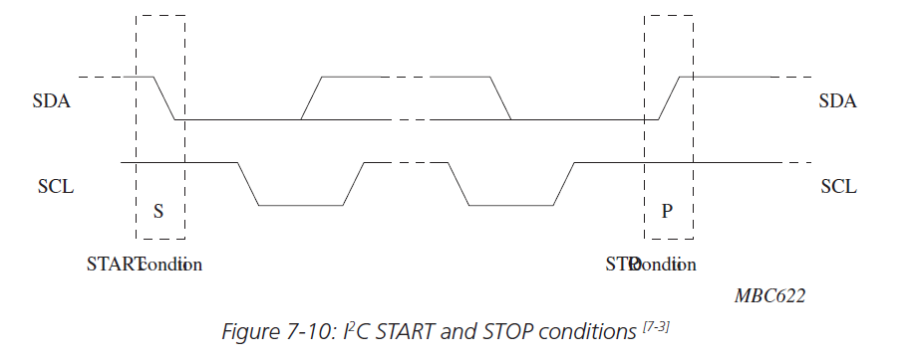
Cont’d

Slide 28
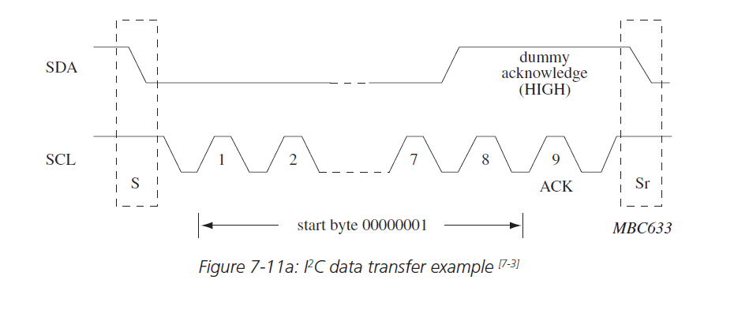
Cont’d

Slide 29
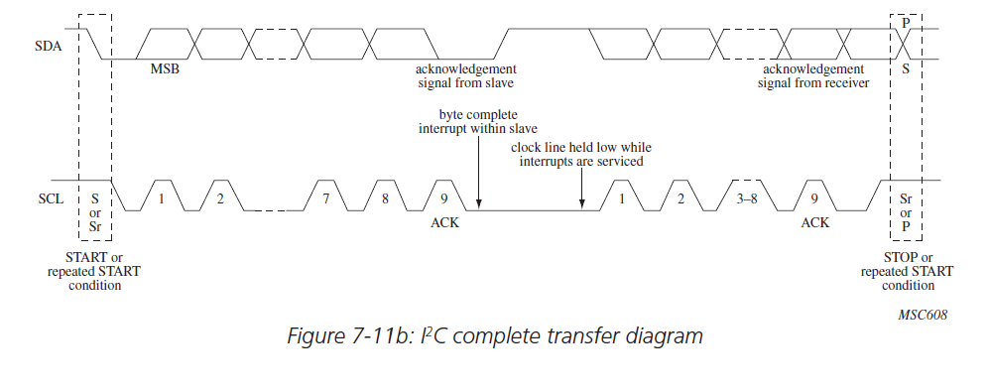
Cont’d

Slide 30
PCI (Peripheral Component Interconnect) Bus Example: Expandable
PCI is a synchronous bus, meaning that it synchronizes communication using a clock
The latest standard defines a PCI bus design with at least a 33 MHz clock (up to 66 MHz) and a bus width of at least 32 bits (up to 64 bits), giving a possible minimum throughput of approximately 132 Mbytes/sec ((33 MHz * 32 bits) / 8)—and up to 528 Mbytes/sec maximum with 64-bit transfers given a 66-MHz clock
PCI runs at either of these clock speeds, regardless of the clock speeds at which the components attached to it are running

Slide 31
Cont’d
PCI bus has two connection interfaces:
an internal PCI interface that connects it to the main board (to bridges, processors, etc.) via EIDE channels,
the expansion PCI interface, which consists of the slots into which PCI adaptor cards (audio, video, etc.) plug
The expansion interface is what makes PCI an expandable bus
It allows for hardware to be plugged into the bus, and for the entire system to automatically adjust and operate correctly

Slide 32
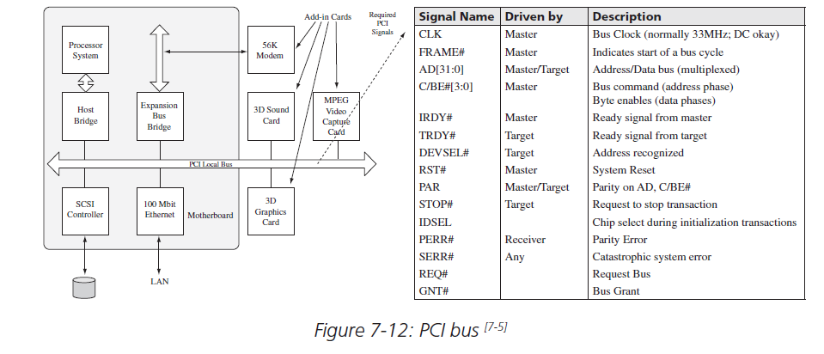
Cont’d

Slide 33
Cont’d
Under the 32-bit implementation, the PCI bus is made up of 49 lines carrying multiplexed data and address signals (32 pins), as well as other control signals implemented via the remaining 17 pins
Because the PCI bus allows for multiple bus masters (initiators of a bus transaction), it implements a dynamic centralized, parallel arbitration scheme
PCI’s arbitration scheme basically uses the REQ# and GNT# signals to facilitate communication between initiators and bus arbitrators
Every master has its own REQ# and GNT# pin, allowing the arbitrator to implement a fair arbitration scheme, as well as determining the next target to be granted the bus while the current initiator is transmitting data

Slide 34
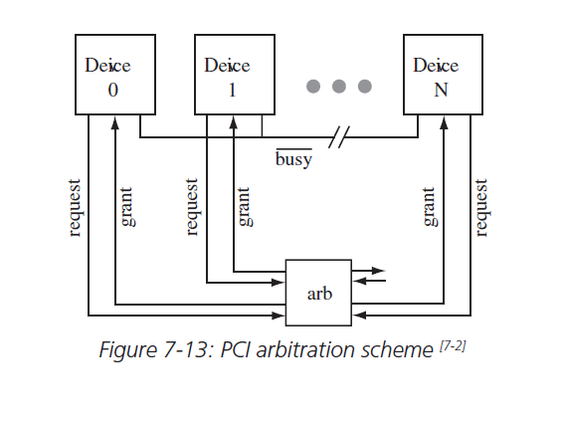
Cont’d

Slide 35
PCI Transaction steps
1. An initiator makes a bus request by asserting a REQ# signal to the central arbitrator
2. The central arbitrator does a bus grant to the initiator by asserting GNT# signal
3. The address phase which begins when the initiator activates the FRAME# signal, and
then sets the C/BE[3:0]# signals to define the type of data transfer (memory or I/O read or write). The initiator then transmits the address via the AD[31:0] signals at the
next clock edge
4. After the transmission of the address, the next clock edge starts the one or more data phases (the transmission of data). Data is also transferred via the AD[31:0] signals. The C/BE[3:0], along with IRDY# and #TRDY signals, indicate if transmitted data is
valid
5. Either the initiator or target can terminate a bus transfer through the deassertion of the #FRAME signal at the last data phase transmission. The STOP# signal also acts to terminate all bus transactions

Slide 36
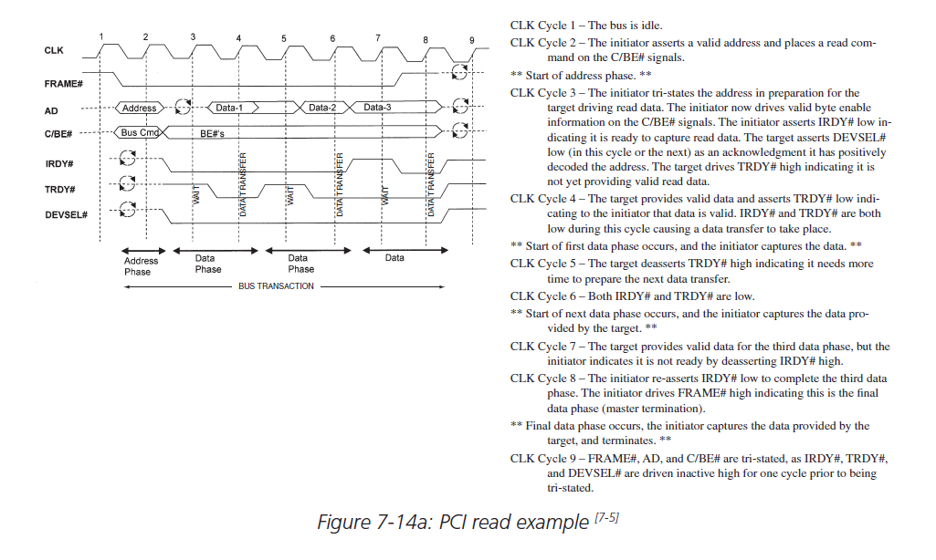
Cont’d

Slide 37
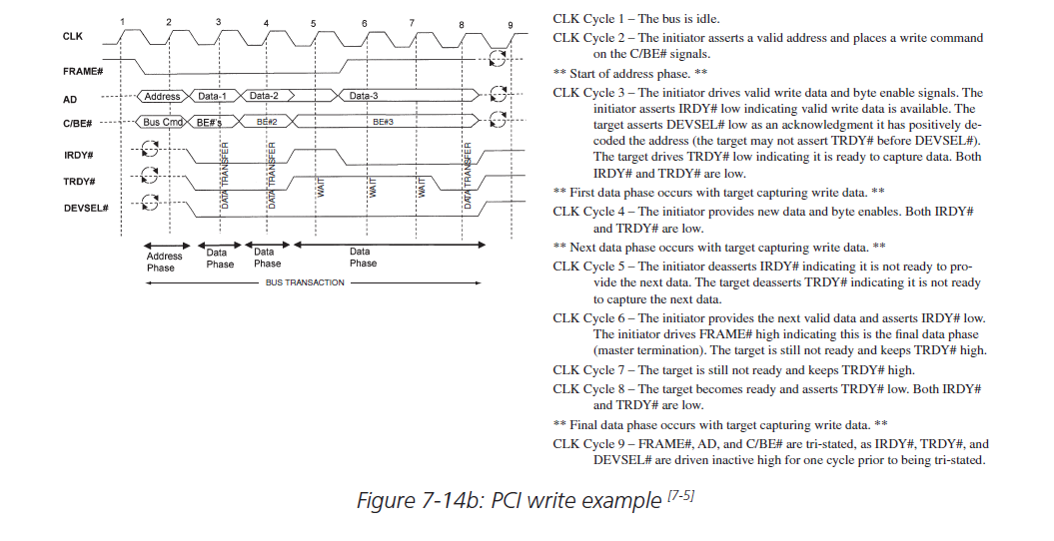
Cont’d

Slide 38
Integrating the Bus with Other Board Components
Buses vary in their physical characteristics, and these characteristics are reflected in the components with which the bus interconnects, mainly the pinouts of processors and memory chips which reflect the signals a bus can transmit
Within an architecture, there may also be logic that supports bus protocol functionality
As discussed earlier this section, the I2C bus is a bus with two signals:
SDA (serial data)
SCL (serial clock)

Slide 39
Cont’d
I2C is a synchronous bus, a baud rate generator within the controller supplies a clock signal if the PowerPC is acting as a master, along with two units (receiver and transmitter) covering the processing and management of bus transactions
In this I2C integrated controller, address and data information is transmitted over the bus via the transmit data register and out the shift register
When the MPC860 receives data, data is transmitted into the receive data register via a shift register

Slide 40
Bus Performance
A bus’s performance is typically measured by
Bandwidth: the amount of data a bus can transfer for a given length of time
A bus’s design—both physical design and its associated protocols—will impact its performance
In terms of protocols, the simpler the handshaking scheme the higher the
The actual physical design of the bus (its length, the number of lines, the number of supported devices, and so on) limits or enhances its performance
The shorter the bus, the fewer connected devices, and the more data lines, typically the faster the bus and the higher its bandwidth
The number of bus lines and how the bus lines are used
For example, whether there are separate lines for each signal or whether multiple signals multiplex over fewer shared lines are additional factors that impact bus bandwidth

Slide 41
Cont’d
The more bus lines (wires), the more data that can be physically transmitted at any one time, in parallel
Fewer lines mean more data has to share access to these lines for transmission, resulting in less data being transmitted at
any one time
Relative to cost, note that an increase in conducting material on the board, in this case the wires of the bus, increases the cost of the board
Note, however, that multiplexing lines will introduce delays on either end of the transmission, because of the logic required on either end of the bus to multiplex and demultiplex signals that are made up of different kinds of information

Slide 42
Cont’d
Another contributing factor to a bus’s bandwidth is
Bus width: The number of data bits a bus can transmit in a given bus cycle (transaction)
Buses typically have a bandwidth of some binary power of 2—such as 1 for buses with a serial bus width, 8 bit, 16 bit, 32 bit, and so on
For example, given 32 bits of data that needs to be transmitted, if a particular bus has a width of 8 bits, then the data is divided and sent in four separate transmissions
Transmission is serial means that only 1 bit at any one time can be transmitted
The bus width limits the bandwidth of a bus because it limits the number of data bits that can be transmitted in any one transaction

Slide 43
Cont’d
Delays can occur in each transmission session, because of handshaking (acknowledgment sequences), bus traffic, and different clock frequencies of the communicating components, that put components in the system in delaying situations, such as a wait state
These delays increase as the number of data packets that need to be transmitted increases
Thus, the bigger the bus width, the fewer the delays, and the greater the bandwidth (throughput)
For buses with more complex handshaking protocols, the transferring scheme implemented can greatly impact performance
A block transfer scheme allows for greater bandwidth over the single transfer scheme, because of the fewer handshaking exchanges per blocks versus single words, bytes (or whatever) of data. On the flip side, block transfers can add to the latency due to devices waiting longer for bus access, since a block transfer-based transaction lasts longer than a single transfer-based transaction

Slide 44
Cont’d
A common solution for this type of latency is a bus that allows for split transactions, where the bus is released during the handshaking, such as while waiting for a reply to acknowledgement
This allows for other transactions to take place, and allows the bus not to have to remain idle waiting for devices of one transaction
However, it does add to the latency of the original transaction by requiring that the bus be acquired more than once for a single transaction

Slide 45
THANK YOU

